Slide 1


OOP
جامعة المرقب
كلية تقنية المعلومات
Arrays of Objects
خريف 2026/2025‏

Slide 2
Arrays
An array is an ordered list of values
Each value has a numeric index
The entire array
has a single name
0 1 2 3 4 5 6 7 8 9
79 87 94 82 67 98 87 81 74 91
Student_id
An array of size N is indexed from zero to N-1
This array holds 10 values that are indexed from 0 to 9

Slide 3
Arrays
Another way to depict the Student_ID array:
Student-ID
79
Student-name
AHMED
87
ALI
94
Khled
82
sami
67
Hamida
All elements in an array should be of the same data type
Student_ID: An array containing numbers values
Student-name : An array containing string values

Slide 4
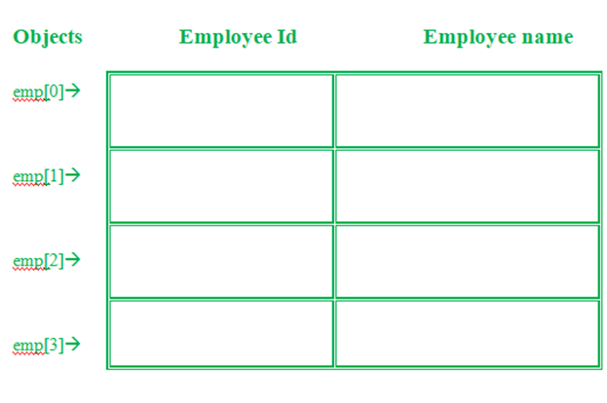
Arrays of Objects
Definition: An array that holds multiple instances of a class(objects).
Example: If you have a class Student , an array of Student objects can hold multiple students instances, each with its own properties like id, name , etc.
79
AHMED
87
Ali
94
Khled
82
sami

Slide 5
Declaring Arrays
When you define a class, you're creating a blueprint for an object. However, this doesn't allocate any memory or storage for the object right away.
Syntax for Declaring Arrays:
ClassName ObjectName[number of objects];
for example : Student STD [7]
This means you can define an array of a 7 objects of the given class named Student.

Slide 6
Example program read and write number and name for three student using array of objects
#include<iostream>
#using namespace std;
class Student
{
public:
int id;
char name[30];
void getdata() {
cout << "Enter Id : ";
cin >> id;
cout << "Enter Name : ";
cin >> name;
}
void putdata() {
cout << "ID: " << id << ", Name: " << name << endl;
}
};

Slide 7
#
int main() {
Student std[3];
cout << "Enter details for 3 Student:\n";
for (int i = 0; i < 3; ++i) {
cout << "\nStudent " << (i + 1) << ":\n";
std[i].getdata();
}
cout << "\nStudents Details:\n";
for (int i = 0; i < 3; ++i) {
std[i].putdata();
}
return 0;}
}

Slide 8
Questions
Q1. Rewrite the last program using default constructor and destructor
Q2. Imagine a Book class write a single line of code to declare an array that can hold 5 book objects

Slide 9
Q3.What is difference between array of integer and string , and array of object?
Student-ID
79
Student-name
AHMED
87
ALI
94
Khled
82
sami
67
Hamida
79
AHMED
87
Ali
94
Khled
82
sami

Slide 10
Example (2)
Items item[5] - This is an array of objects having a maximum limit of 5 items .
Two for loops are being used-
  First one to take the input from user by calling t[i].getdata() function.
  Second one to print the data of Employee by calling the function t[i].putdata() function.

Slide 11
class item{
char name[30];
int price;
public:
void getitem()
{
cout << "Item Name = ";
cin >> name;
cout << "Price = ";
cin >> price; }
void putdata(){
cout << "Item Name = ";
cin >> name;
cout << "Price = ";
cin >> price;
}};

Slide 12
int main(){
item t[5];
for(int i = 0; i < size; i++)
{
cout << "Item : " << (i + 1) << "\n";
t[i].getitem();
}
for(int i = 0; i < size; i++)
{
cout << "Item Details : " << (i + 1) << "\n";
t[i].printitem();}
}

